Slide 1


Slide 2


Slide 3
Designing automatically updating AI with Apache Kafka and Deeplearning4j
Jason Bell – ClojureX 2018

Slide 4
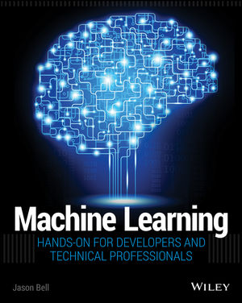
All Tweet heckling is perfectly allowed.
@jasonbelldata

Slide 5
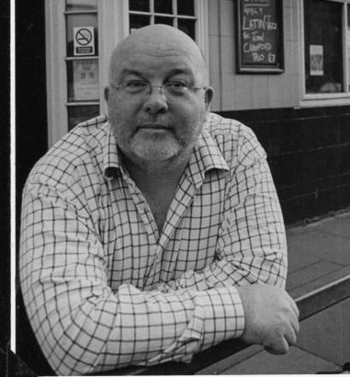
In 1991 this man taught me about prediction with data.
How do you predict the top ten singles to order for next week? With only some bits of cardboard and no computer?

Slide 6

JASE, WE’RE GONNA DO AI!

Slide 7
Jase, we’re gonna do….
1994 – Perl
1995 – Dale a tu cuerpo alegria Macarena, Hey Macarena
1996 – Java Applets
2000 – XML
2002 – Web 2.0
2004 – Open Data Social Collaboration
2007 – iPhone Apps, it’s the App Economy DUDE!
2009 – Mobile Web Apps
2012 – Hadoop! (WTF is that Jase?)
2013 – Spark! (See above)
2017 – Realtime Data Streaming Kafka
2018 - AI / ML / Ay Aye (Yorkshire Machine Learning)

Slide 8
We’re going to build a system to build self training AI but I need you to have skin in the game.

Slide 9
So you’re going to replace a job of a human being.

Slide 10
(let [boo 0])

Slide 11

The Darcey Prediction AI - How could you!

Slide 12
(inc boo)

Slide 13

It’s okay, they’ve broken the news.

Slide 14
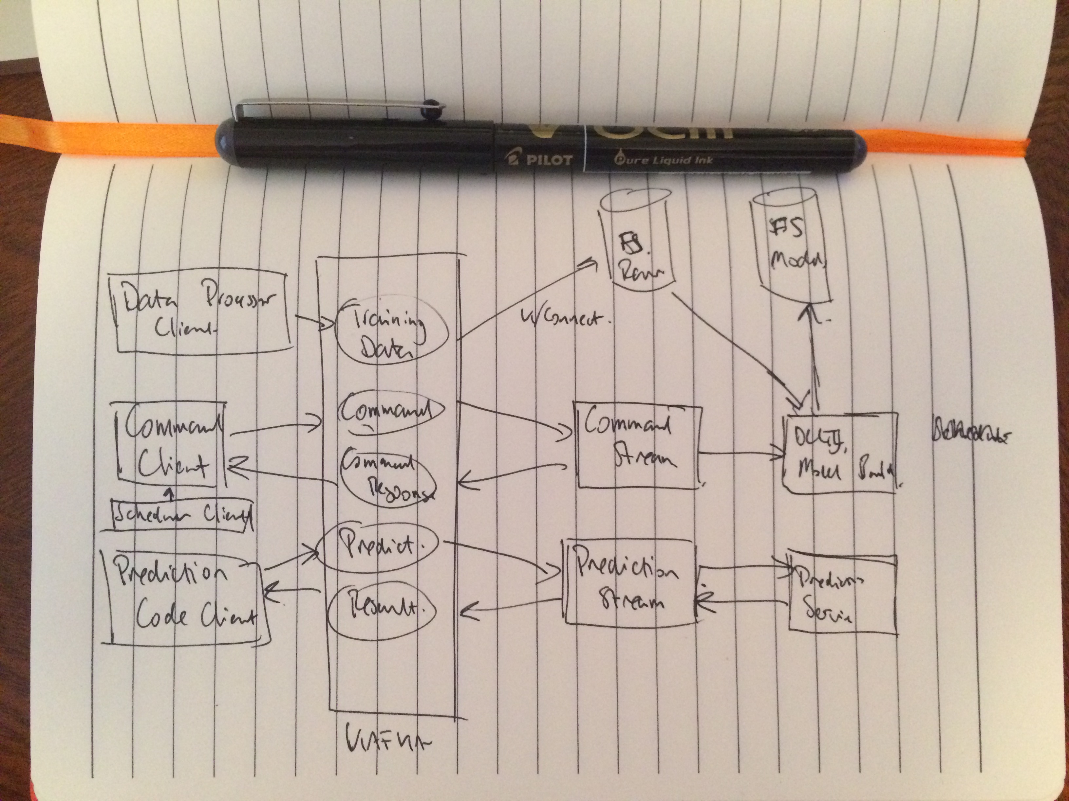
It all starts with a cup of tea, a notepad and a pen…

Slide 15
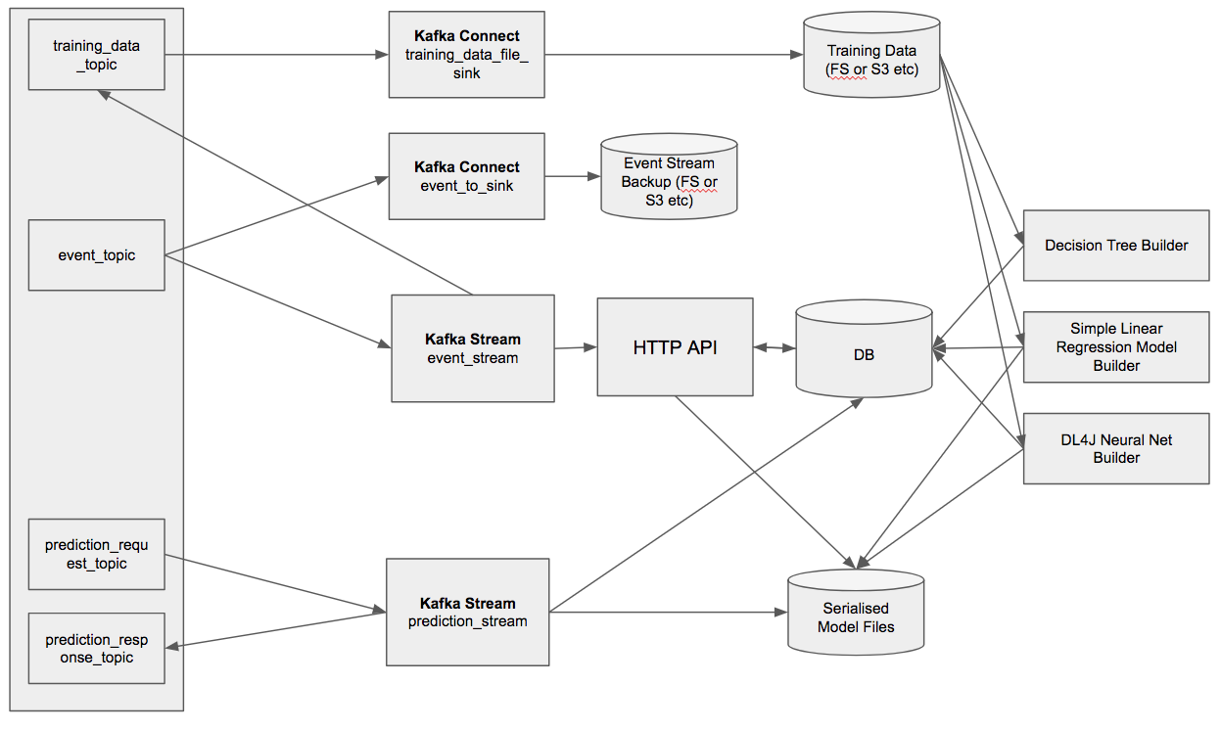

Slide 16
Let’s break it down a bit…..
Kafka Topics, Connect and Streams
Filesystem (or S3 etc)
A HTTP API
Model Builders
And a Database

Slide 17
Covering these main concepts
Events
Model Training
Model Prediction

Slide 18
Setting Up Kafka

Slide 19
Events and Training Data Topics
# training_data_topic - Where the raw data will be transported for training. Using Kafka Connect to push the data to a filestore.
echo "Creating topic: training_data_topic”
$KAFKA_HOME/bin/kafka-topics.sh --create --topic training_data_topic --zookeeper $ZK_CONNECT --partitions $PARTITIONS --replication-factor $REPLICATION_FACTOR
—*****—
# event_stream_topic - Events are sent to the Events Kafka Streaming API application.
echo "Creating topic: event_topic"
$KAFKA_HOME/bin/kafka-topics.sh --create --topic event_topic --zookeeper $ZK_CONNECT --partitions $PARTITIONS --replication-factor $REPLICATION_FACTOR

Slide 20
Prediction Request/Response Topics
# prediction_request_topic - Sends data to the Prediction Streaming application.
echo "Creating topic: prediction_request_topic”
$KAFKA_HOME/bin/kafka-topics.sh --create --topic prediction_request_topic --zookeeper $ZK_CONNECT --partitions $PARTITIONS --replication-factor $REPLICATION_FACTOR
—*****—
# prediction_response_topic - The prediction response from the original prediction_request_topic
echo "Creating topic: prediction_response_topic"
$KAFKA_HOME/bin/kafka-topics.sh --create --topic prediction_response_topic --zookeeper $ZK_CONNECT --partitions $PARTITIONS --replication-factor $REPLICATION_FACTOR

Slide 21
Persisting Event Messages

Slide 22
Everything is an event
It’s my single source of truth for training and commands, kind of.
I want to replay the product from message event zero.
I want to persist every event to the filesystem.
{“type”:”command”, “payload”:”build_mlp”…}
{“type”:”command”, “payload”:”build_dtr”…}
{“type”:”command”, “payload”:”build_slr”…}
{“type”:”training”, “payload”:”3,4,5,7”…}

Slide 23
Using Kafka Connect to Persist Events
name=dl4j-eventsw-file-sink
connector.class=FileStreamSink
tasks.max=1
file=/home/jason/testdata/events/events.json
topic=event_topic
key.converter=org.apache.kafka.connect.storage.StringConverter
value.converter=org.apache.kafka.connect.storage.StringConverter

Slide 24
Using Kafka Connect to Persist
Training Data
name=dl4j-training-data-file-sink
connector.class=FileStreamSink
tasks.max=1
file=/home/jason/testdata/connect/alldata.csv
topics=training_data_topic
key.converter=org.apache.kafka.connect.storage.StringConverter
value.converter=org.apache.kafka.connect.storage.StringConverter

Slide 25
Using Kafka Connect
bin/connect-standalone.sh \
config/connect-standalone.properties \
dl4j_event_to_fs_sink.properties dl4j_to_fs_sink.properties

Slide 26
Processing Event Messages

Slide 28
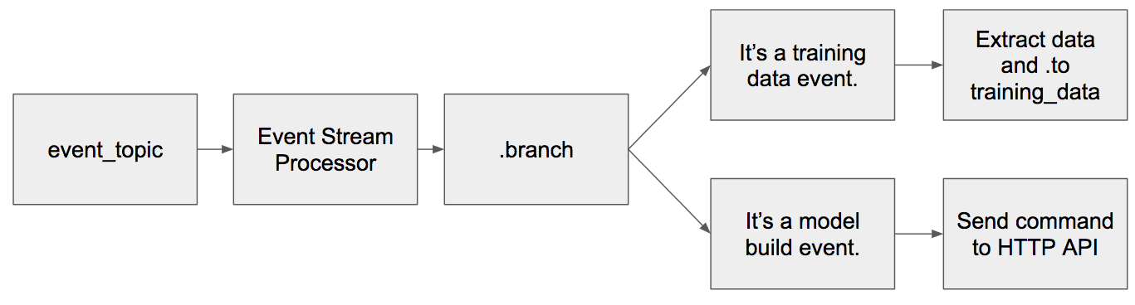
The Kafka Stream Event App

Slide 29
The Kafka Stream Event App
(Is it training data or a command?)
(let [partitioned-stream
(.branch
(.stream builder input-topic)
(into-array Predicate [(reify
Predicate
(test [_ _ v]
(do
(log/info "p0 " v)
(->> v
(pre-process-data)
(pred-key-type "command")))))
(reify
Predicate
(test [_ _ v]
(do
(log/info "p1 " v)
(->> v
(pre-process-data)
(pred-key-type "training")))))]))

Slide 30
The Kafka Stream Event App
(Process the two types of message)
(-> (aget partitioned-stream 0)
(.mapValues (reify ValueMapper (apply [_ v] (process-command v))))
(.print))
(-> (aget partitioned-stream 1)
(.mapValues (reify ValueMapper (apply [_ v] (process-training v))))
(.to training-topic-name)))

Slide 31
The Kafka Stream Event App
;; Process any commands, basically fire them at the HTTP API.
(defn process-command [data-in]
(let [jsonm (pre-process-data data-in)]
(slurp (str api-endpoint (:payload jsonm)))))
;; Extract the CSV training data and return it.
(defn process-training [data-in]
(let [jsonm (pre-process-data data-in)]
(.getBytes (:payload jsonm))))

Slide 32
Models

Slide 34
Model use three frameworks.
Neural Networks in DeepLearning4J
Decision Trees in Weka
Linear Regression with Apache Commons Math

Slide 35
Model use three frameworks.
Neural Networks in DeepLearning4J
Decision Trees in Weka
Linear Regression with Apache Commons Math
A 200% Talk Bonus!

Slide 36
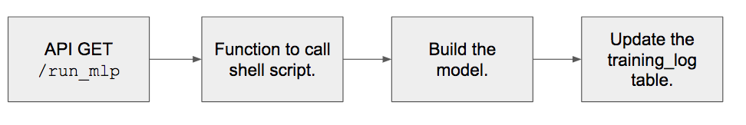
Basic Flow of the Model Builds for Neural Networks and Decision Trees

Slide 37
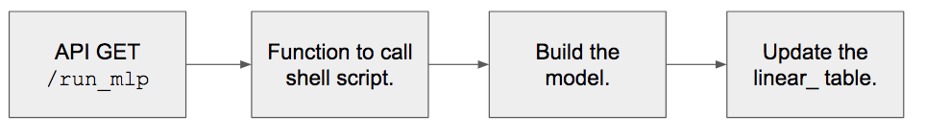
Basic Flow of the Model Builds for Simple Linear Regression

Slide 38
The HTTP API receives commands from the Event Stream App
(GET "/build_mlp" []
:return {:result String}
:summary "Builds the neural network model"
(ok {:result (mlp/run-model-build)}))
(def script-path “/home/jason/work/clojurex-2018-kafka-dl4j-clojure/projects/dl4j.mlp/scripts/runmlp.sh")
(defn run-model-build []
(sh script-path)
"Neural Network built.")

Slide 39
The endpoint calls the function to run the script.
#!/bin/bash
JAR_PATH=/home/jason/work/clojurex-2018-kafka-dl4j-clojure/projects/dl4j.mlp/out/artifacts/ClojureX2018Java_jar/ClojureX2018Java.jar
java -cp .:..:$JAR_PATH eu.jasebell.strata2018.mlp.ANNBuilder

Slide 40
Neural Net Code in DL4J (Java)
MultiLayerConfiguration conf = new NeuralNetConfiguration.Builder()
.seed(seed)
.iterations(iterations)
.activation(Activation.TANH)
.weightInit(WeightInit.XAVIER)
.learningRate(0.1)
.regularization(true).l2(1e-4)
.list()
.layer(0, new DenseLayer.Builder().nIn(numInputs).nOut(hiddenNodes).build())
.layer(1, new DenseLayer.Builder().nIn(hiddenNodes).nOut(hiddenNodes).build())
.layer(2, new DenseLayer.Builder().nIn(hiddenNodes).nOut(hiddenNodes).build())
.layer(3, new OutputLayer.Builder(LossFunctions.LossFunction.NEGATIVELOGLIKELIHOOD)
.activation(Activation.SOFTMAX)
.nIn(hiddenNodes).nOut(outputNum).build())
.backprop(true).pretrain(false)
.build();
//run the model
MultiLayerNetwork model = new MultiLayerNetwork(conf);
model.init();
model.setListeners(new ScoreIterationListener(100));
model.fit(trainingData);

Slide 41
Neural Net Code in DL4J (Clojure)
(ns skynet.core
(:require [jutsu.ai.core :as ai]))
;;Example configuration of a simple multilayer feedforward neural network architecture
;;classifying the iris dataset.
(def iris-net-config
[:layers
[[:dense [:n-in 4 :n-out 10 :activation :relu]]
[:dense [:n-in 10 :n-out 10 :activation :relu]]
[:output :negative-log-likelihood [:n-in 10 :n-out 3 :activation :softmax]]]])
(def iris-net
(-> iris-net-config
ai/network
ai/initialize-net))
(defn iris-train []
(let [iris-iterator (ai/classification-csv-iterator "iris.csv" 150 4 3)]
(-> iris-net
(ai/train-net! 200 iris-iterator)
(ai/save-model "iris-model"))
(.reset iris-iterator)
(println (ai/evaluate iris-net iris-iterator))))
(iris-train)

Slide 42
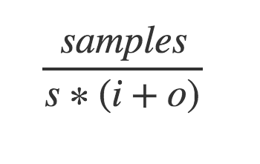
How many hidden nodes?
s= A number between 2 and 11
i= Input Nodes count
o= Output nodes count

Slide 43
Decision Trees in Weka in Java
J48 cls = new J48();
try {
Instances inst = new Instances(new BufferedReader(new FileReader("/home/jason/testdata/alldata.arff")));
inst.setClassIndex(inst.numAttributes() - 1);
try {
long start = System.currentTimeMillis();
cls.buildClassifier(inst);
Evaluation evaluation = new Evaluation(inst);
Random rand = new Random(1);
int folds = 10;
evaluation.crossValidateModel(cls, inst, folds, rand);
long stop = System.currentTimeMillis();
DBTools.writeResultsToDB(uuid, -1, (stop - start), evaluation.pctCorrect()/100, evaluation.toSummaryString(), "dtr");
} catch (Exception e) {
e.printStackTrace();
}

Slide 44
Decision Trees in Weka in Clojure
(defn load-instance-data [file-url]
(woi/load-instances :arff file-url))
(defn train-dtree [training-data-filename]
(let [instances (load-instance-data training-data-filename)
dtree (classifier/make-classifier :decission-tree :c45)]
(data/dataset-set-class instances 3)
(classifier/classifier-train dtree instances)))
Note: clj-ml has not been updated since September 2015.

Slide 45
Simple Linear Regression with Apache Commons Math
private SimpleRegression getLinearRegressionModel(List<String> lines) {
SimpleRegression sr = new SimpleRegression();
for(String s : lines) {
String[] ssplit = s.split(",");
double x = Double.parseDouble(ssplit[0]);
double y = Double.parseDouble(ssplit[1]);
sr.addData(x,y);
}
return sr;
}

Slide 46
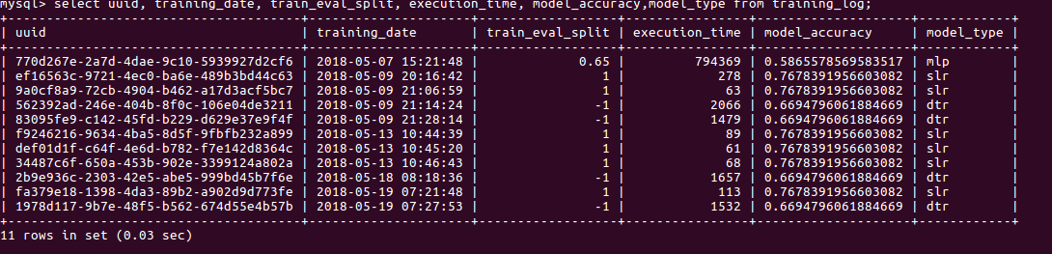
The database is updated with info about the model build.

Slide 47
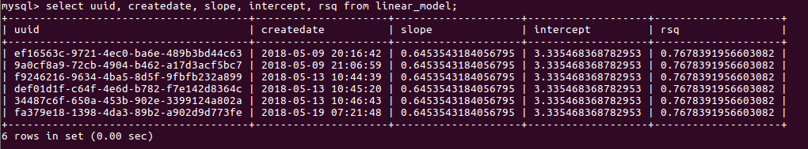
With Linear Regression the slope and intercept are written to the DB.

Slide 48
Making Predictions

Slide 50
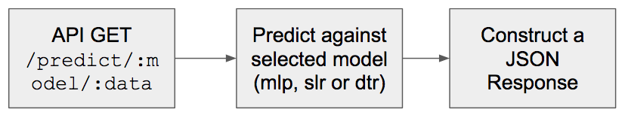
Two methods to make a prediction. 1. Direct calls to the HTTP API

Slide 51
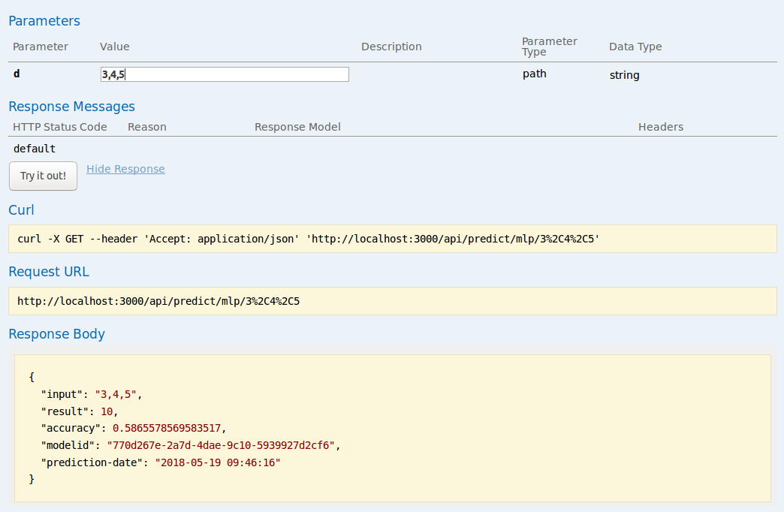
Two methods to make a prediction. 1. Direct calls to the HTTP API

Slide 52
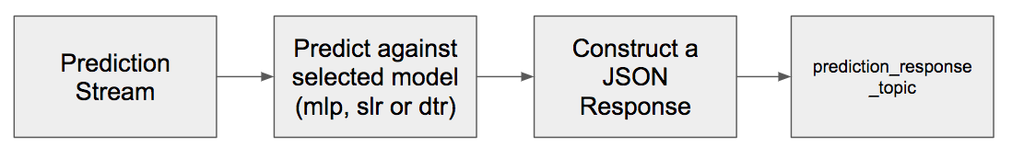
2. Send a message to the prediction_request_topic

Slide 53
2. Send a message to the prediction_request_topic
{“model”:”mlp”,”payload”:”3,4,5”}

Slide 54
Predictions within Streaming Apps (NN in DL4J).
(defn make-prediction [model input]
(let [input-vector (Nd4j/create (split-input input))
prediction (.output model input-vector)]
(.iamax (Nd4j/getBlasWrapper) prediction)))
(defn predict-mlp [x]
(let [model-info (get-most-accurate-model)
model (load-mlp-model (:uuid model-info))
prediction (make-prediction model x)]
{:input x
:result prediction
:accuracy (:model_accuracy model-info)
:modelid (:uuid model-info)
:prediction-date (f/unparse (f/formatters :mysql) (t/now))}))

Slide 55
Predictions within Streaming Apps (DT in Weka).
(defn classify-instance [model instance]
(do
(.setClassIndex instance(- (.numAttributes instance) 1))
(.classifyInstance model (.instance instance 0))))
(defn predict-decision-tree [x]
(let [instance (create-instance x)
model-info (get-most-accurate-model)
model (load-model (:uuid model-info))
result (classify-instance model instance)]
{:input x
:result result
:accuracy (:model_accuracy model-info)
:modelid (:uuid model)
:prediction-date (f/unparse (f/formatters :mysql) (t/now))}))

Slide 56
Predictions within Streaming Apps (SLR).
(defn calc-linear [slope intercept x]
(+ intercept (* x slope)))
(defn predict-simple-linear [x]
(let [model (first (load-simple-linear))
input (convert-input-to-integer x)
result (calc-linear (:slope model)
(:intercept model)
input)]
{:input input
:result result
:accuracy (:rsq model)
:modelid (:uuid model)
:prediction-date (f/unparse (f/formatters :mysql) (t/now))}))

Slide 57
Retraining

Slide 58
Retraining the Models
I’m using Cron to rerun the models daily.
Sending a message to the event_topic keeps the event stream order preserved.
Remember training results are in the database.

Slide 59
Improvements?

Slide 60


Slide 61
Improving the DL4J Model Builds.
Modify the Event Streaming app to map through the scaling factor to create ten new models.
Container the model build: start -> complete -> terminate. Could use Fargate/K8s etc
Let developers develop Keras models and let DL4J handle the predictions?

Slide 62
Predictions
Model loading is slow, I could persist them in RAM.
Consider how to update newer more accurate models.
Predict against all models - The Rendezvous Model.

Slide 63
Random Samples of Training Data
Use Hadoop to create random samples.
Store the results (part-00000 etc)
Run the training on the results.
Link the training bundle to the result set (use same uuid etc)
Large data volumes would kill Weka model builds.

Slide 64
Random Samples of Training Data
public static class RandomSampleMapper extends Mapper<Object, Text, NullWritable, Text> {
private Random rands = new Random();
private Double percentage;
@Override
protected void setup(Context context) throws IOException, InterruptedException {
String strPercentage = context.getConfiguration().get("percentage");
percentage = Double.parseDouble(strPercentage) / 100.0;
}
@Override
public void map(Object key, Text value, Context context)
throws IOException, InterruptedException {
if (rands.nextDouble() < percentage) {
context.write(NullWritable.get(), value);
}
}
}

Slide 65
https://github.com/jasebell/clojurex-2018

Slide 66
Thank you.
Twitter: @jasonbelldata

